Slide 1
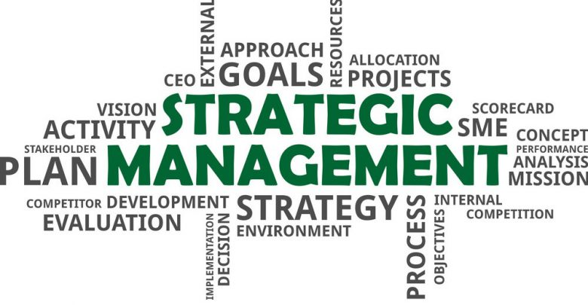
UNIT III

Slide 2
CONTENTS
Introduction to Strategic Management
Vision
Mission
Goals
Objectives
Environmental Scanning – PESTEL, SWOT analysis, Porter’s five force model
Competitive Advantage
Concept of Core competence
Types of Strategies
Strategic formulation and Implementation

Slide 3
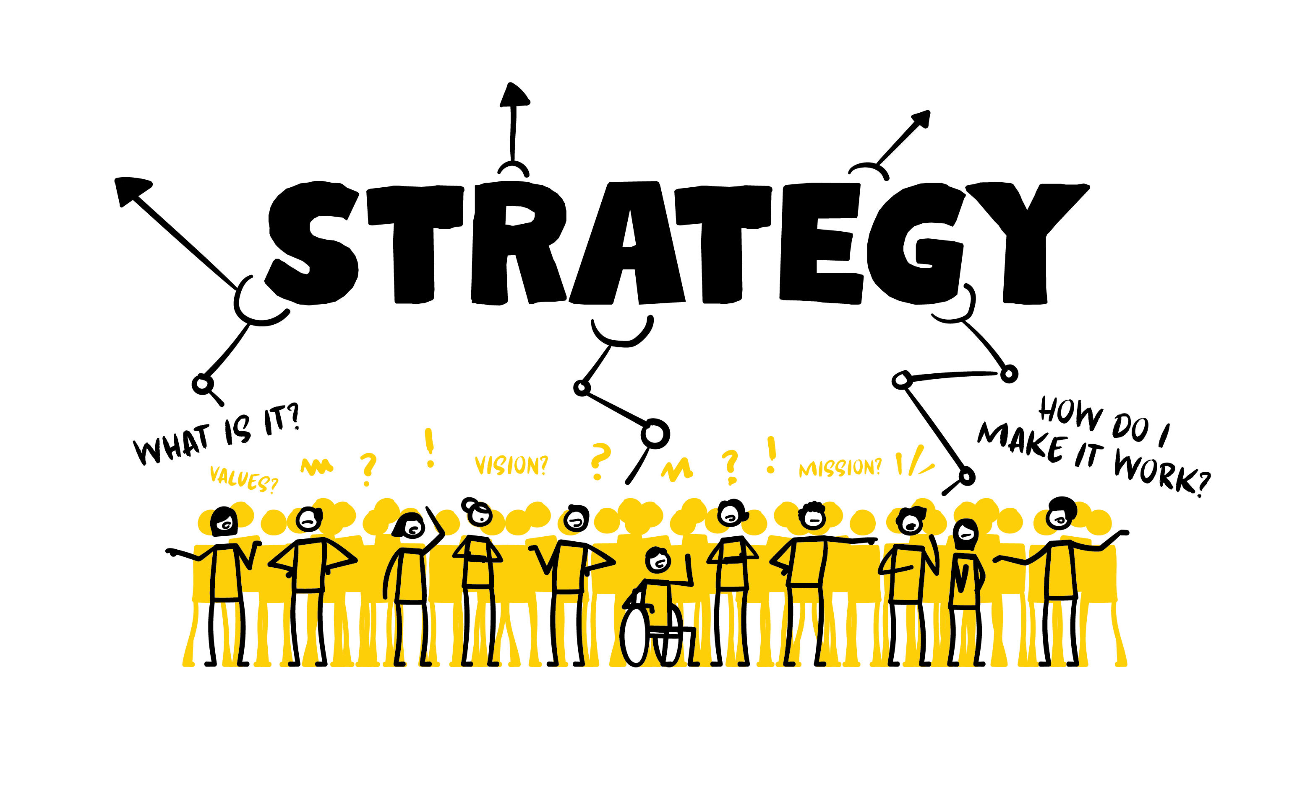
What is a Strategy?
A general direction set for the company and its various components to achieve a desired state in the future.

Slide 4

INTRODUCTION
The Strategic Management process is the way in which strategists determine objectives and make strategic decisions.

Slide 5

DEFINITION
Strategic Management is a stream of decisions and actions which lead to the development of an effective strategy or strategies to help achieve corporate objectives.

Slide 6
KEY POINTS
Strategic Management is a stream of decisions and actions.
It leads to the development of an effective strategy or strategies to help achieve corporate objectives.
It is an on-going process that evaluates and controls the business and the industries in which the company is involved.

Slide 7

VISION
A Vision is a clear and comprehensive photograph of the organization at some point in the future. It provides direction because it describes what the organization needs to be like, to be successful in the future.

Slide 8
Examples: Vision Statement
Starbucks
Establish Starbucks as the premier purveyor of the finest coffee in the world while maintaining our uncompromising principles while we grow.
Honda
Maintaining a global viewpoint, we are dedicated to supplying products of the highest quality, yet at a reasonable price for worldwide customer satisfaction.

Slide 9

MISSION
Mission statement defines the basic reason for the existence of an organization and provides the basic philosophy of what the company is all about.

Slide 10

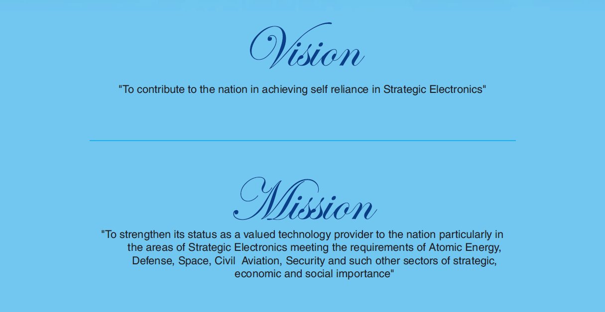
Examples: Mission Statement

Slide 11


Google’s mission: To organize the world’s information and make it universally accessible and useful.
ITC’s mission: To enhance the wealth generating capability of the enterprise in a globalizing environment, delivering superior and sustainable stakeholder value

Slide 12

GOALS
Goals are the overall objectives of a department or an organization. It is defined as what an organization wants to achieve during or by the end of a given period.

Slide 13
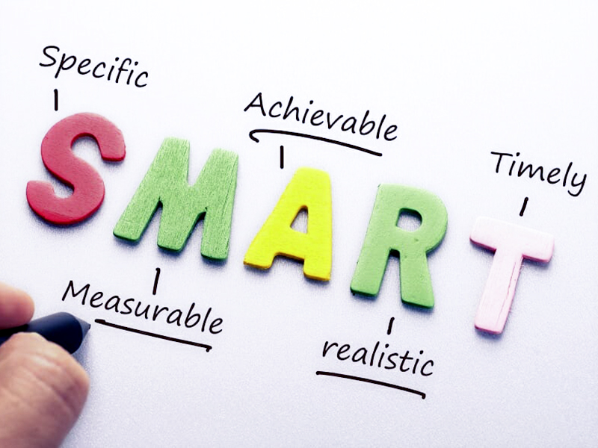
GOALS

Slide 14
GOALS
Specific - The Goal should be specific enough so that we know exactly what we are striving for.
Measurable – A goal should have concrete facts. One should be able to answer very clearly, when and how One will know that the goal is attained.
Achievable – A goal needs to be quantitative and in consensus with the strengths of the organization.

Slide 15
GOALS
Realistic – Goal needs to be more pragmatic and real.
Timely – Goals need to fixed at the proper time so that they help in the overall development of the organization. They are to be set timely and also with a time limit.

Slide 16
OBJECTIVES
Once the mission is clear, goals are fixed for individual departments, the next stage is to break down the goal into objectives for every level in the organization.
A management objective is the intended goal that prescribes definite scope and suggests direction to the planning efforts of a manager.

Slide 17
VISION TO OBJECTIVES
Enduring reasons Specific results
Why an organization that an individual
Exists in the orgn achieves
in a specific period.

Slide 18
ENVIRONMENTAL SCANNING
Environmental scanning is an important component of strategic planning as it provides information on factors that will affect the organization in the future. The information gathered will allow leadership to proactively respond to external impacts.
Once an organization has gathered information about the external world, its competitors and itself, it should then develop strategies to respond to impacts when the need arises.

Slide 19
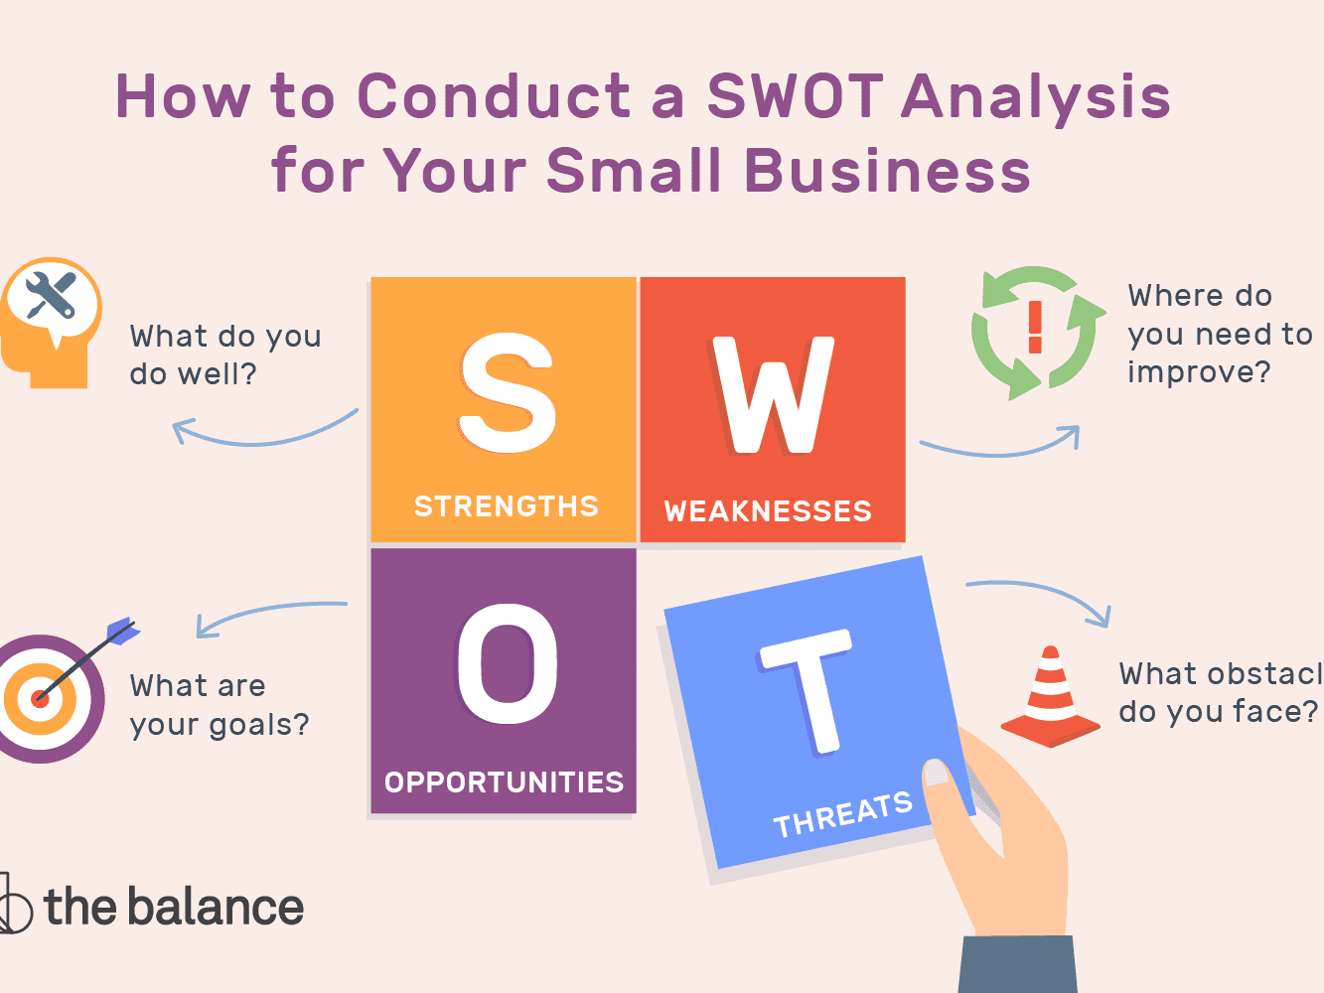
SWOT ANALYSIS

Slide 20
SWOT ANALYSIS
Strengths (S):
Strong presence in the local market
Well established customer base
Good financial performance
Availability of skilled workforce
Backing from financial institutions

Slide 21
SWOT ANALYSIS
Weaknesses (W):
Insular and inflexible organizational culture
Worn-out plant and equipment
Inadequate systems and controls
Dependence on automotive end-users
Inadequate knowledge of appropriate technology

Slide 22
SWOT ANALYSIS
Opportunities (O):
Large potential for exports
India’s emergence as a source-base
Access to new manufacturing process and technology
Realignment in the auto-supplier industry
Encouragement from the government in terms of subsidies, lower taxes and others

Slide 23
SWOT ANALYSIS
Threats (T):
Dominance of the small sector
Customer’s emphasis on just-in-time delivery
Absence of entry barriers into industry
Demand fluctuations in the domestic market
High rate of labor turnover

Slide 24
SWOT Analysis - Significance
SWOT analysis provides four alternative strategies to deal with the factors in the external and the internal environment.
They are:
    The Threat-Weakness (TW) strategy
    The Opportunity-Weakness (OW) strategy
    The Strength-Threat (ST) strategy
    The Strength-Opportunity (SO) strategy

Slide 25
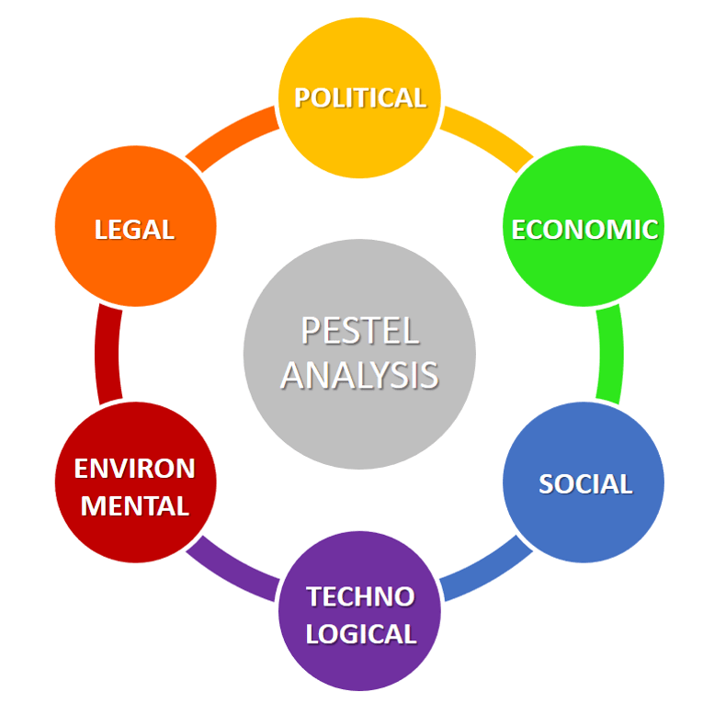
PESTEL FRAMEWORK
There are many factors in the macro-environment that will effect the decisions of the managers of any organization.
To help analyze these factors managers can categorize them using the PESTEL model.

Slide 26
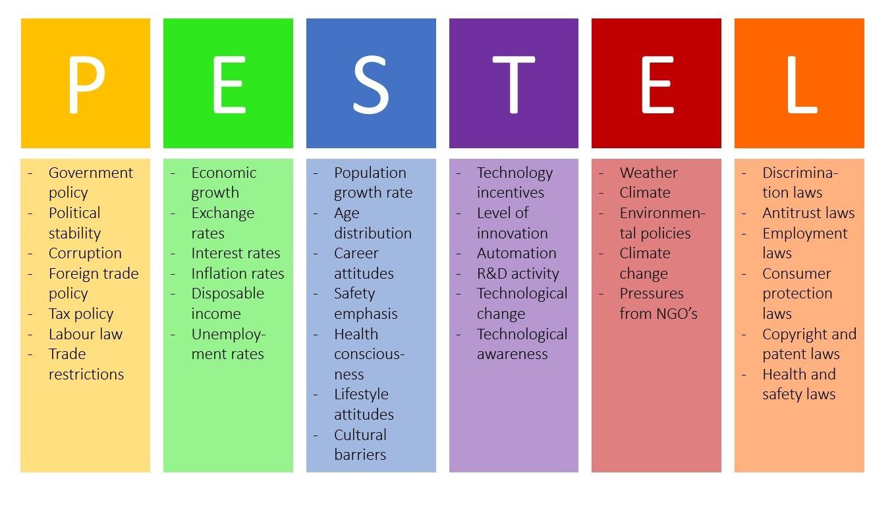
PESTEL FRAMEWORK

Slide 27

MICHAEL PORTER’S FIVE FORCES MODEL
“An industry’s profit potential is largely determined by the intensity of competitive rivalry within that industry”

Slide 28
MICHAEL PORTER’S
FIVE FORCES MODEL
The model of the Five Competitive Forces was developed by Michael E. Porter to determine the intensity of competition and hence the profitability and attractiveness of an industry.
Porter's Five Forces is a model that identifies and analyzes five competitive forces that shape every industry and helps determine an industry's weaknesses and strengths.

Slide 29
MICHAEL PORTER’S
FIVE FORCES MODEL
Five Forces analysis is frequently used to identify an industry's structure to determine corporate strategy. Porter's model can be applied to any segment of the economy to understand the level of competition within the industry and enhance a company's long-term profitability.

Slide 30
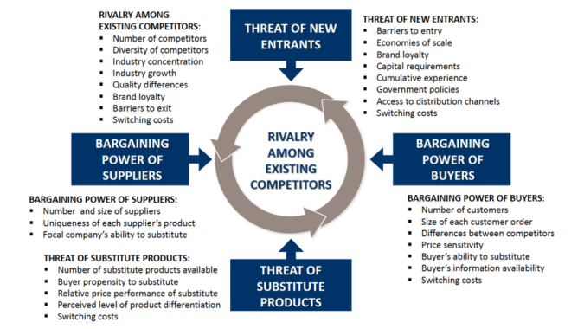

Slide 31

COMPETITIVE ADVANTAGE
Competitive Advantage is something that places a company or person ahead in the competition.
Competitive advantage is the leverage a business has over its competitors.

Slide 32
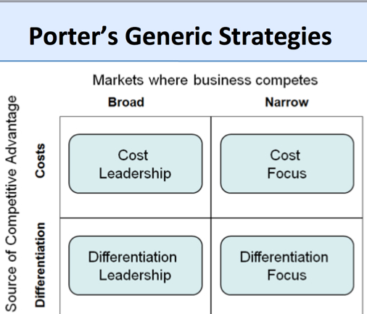
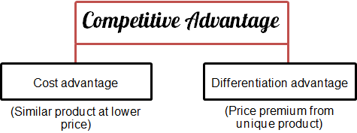
COMPETITIVE ADVANTAGE

Slide 33
CORE COMPETENCE
Core competency is an organization's defining strength, providing the foundation from which the business will grow, seize upon new opportunities and deliver value to customers.
A company's core competency is not easily replicated by other organizations, whether existing competitors or new entries into its market.
Ex: Apple – Innovation
Titan - Watch designs
Walmart - Costing.

Slide 34
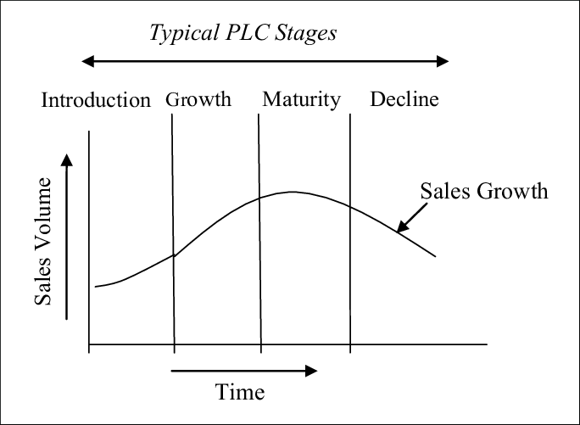
PRODUCT LIFE CYCLE

Slide 35
Types of Strategies
With respect to Products/Markets/Functions
1. EXPANSION STRATEGY: They are adopted in case of highly competitive and volatile industries in introduction stage of product/service life cycle.
2. STABILITY STRATEGY: It is better choice when environment is less volatile and product reached maturity stage of PLC

Slide 36
Types of Strategies
3. RETRENCHMENT STRATEGY: This strategy is best when the firm is not doing well in terms of sales & revenue and finding greater returns some where or when the product is in decline stage of PLC.
4. COMBINATION STRATEGY: It combines other strategies, suitable for multiple Strategic Business Units (SBU) and changes occurs in PLC.
Ex: Sub-contracting, Cross-licensing, Joint ventures

Slide 37
Strategy Formulation
Strategy formulation is the process by which an organization chooses the most appropriate courses of action to achieve its defined goals.
This process is essential to an organization's success, because it provides a framework for the actions that will lead to anticipated results.
Strategy Implementation
Strategic implementation is a process that puts plans and strategies into action to reach desired goals.

Slide 38
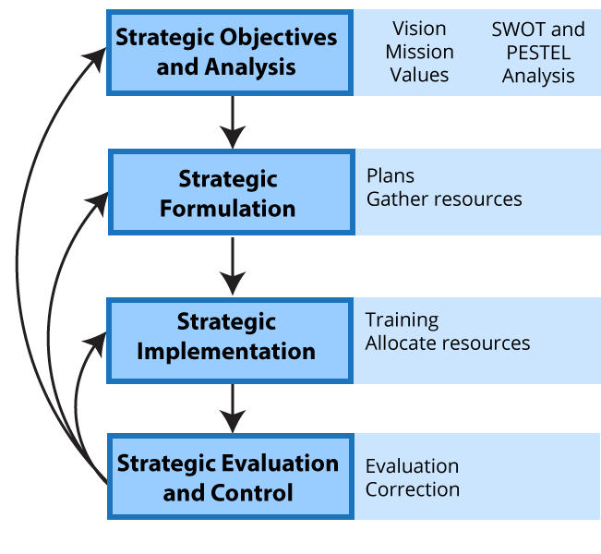
STRATEGIC FORMULATION AND IMPLEMENTATION

Slide 39
END

